Slide 1



Introduction to Spotify Data Analysis and Visualization
Explore the fascinating world of Spotify data analysis and visualization, uncovering insights and trends within music streaming patterns.

Slide 2

Understanding the data sources and formats
Spotify API
Raw Data Formats
Access to a wealth of data, including user playlists, artist information, and track features.
Data may come in JSON, CSV, or relational database formats, each requiring unique handling.
Streaming Data
Real-time data from the platform, providing insights into user interactions and current trends.

Slide 3

Data Cleaning and Preprocessing
Identify and remove missing values: Utilize techniques such as imputation or deletion
Standardize and normalize data: Ensure consistency and comparability across variables
Handle outliers: Address anomalies that may affect analysis results

Slide 4

Exploratory Data Analysis (EDA) using R
During the exploratory data analysis phase, we dive deep into Spotify’s datasets to uncover trends, patterns, and outliers. Utilizing R's powerful statistical and visualization tools, we gain valuable insights into user behaviors and music preferences.
By examining various data metrics, we can identify correlations, anomalies, and potential areas for further investigation, leading to the discovery of actionable insights for the music streaming platform.

Slide 5
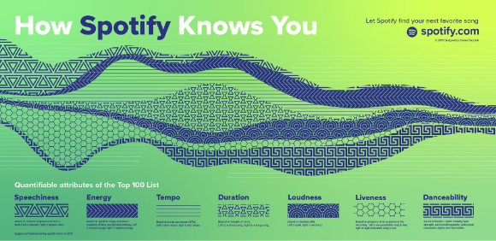
Visualizing Spotify Data with R Packages
Visualizing Spotify data with R packages allows for insightful exploration of music trends, user preferences, and genre analysis. Using powerful visualization tools, such as ggplot2 and plotly, we can create interactive and visually appealing graphs and charts to uncover patterns and correlations within the data.

Slide 6
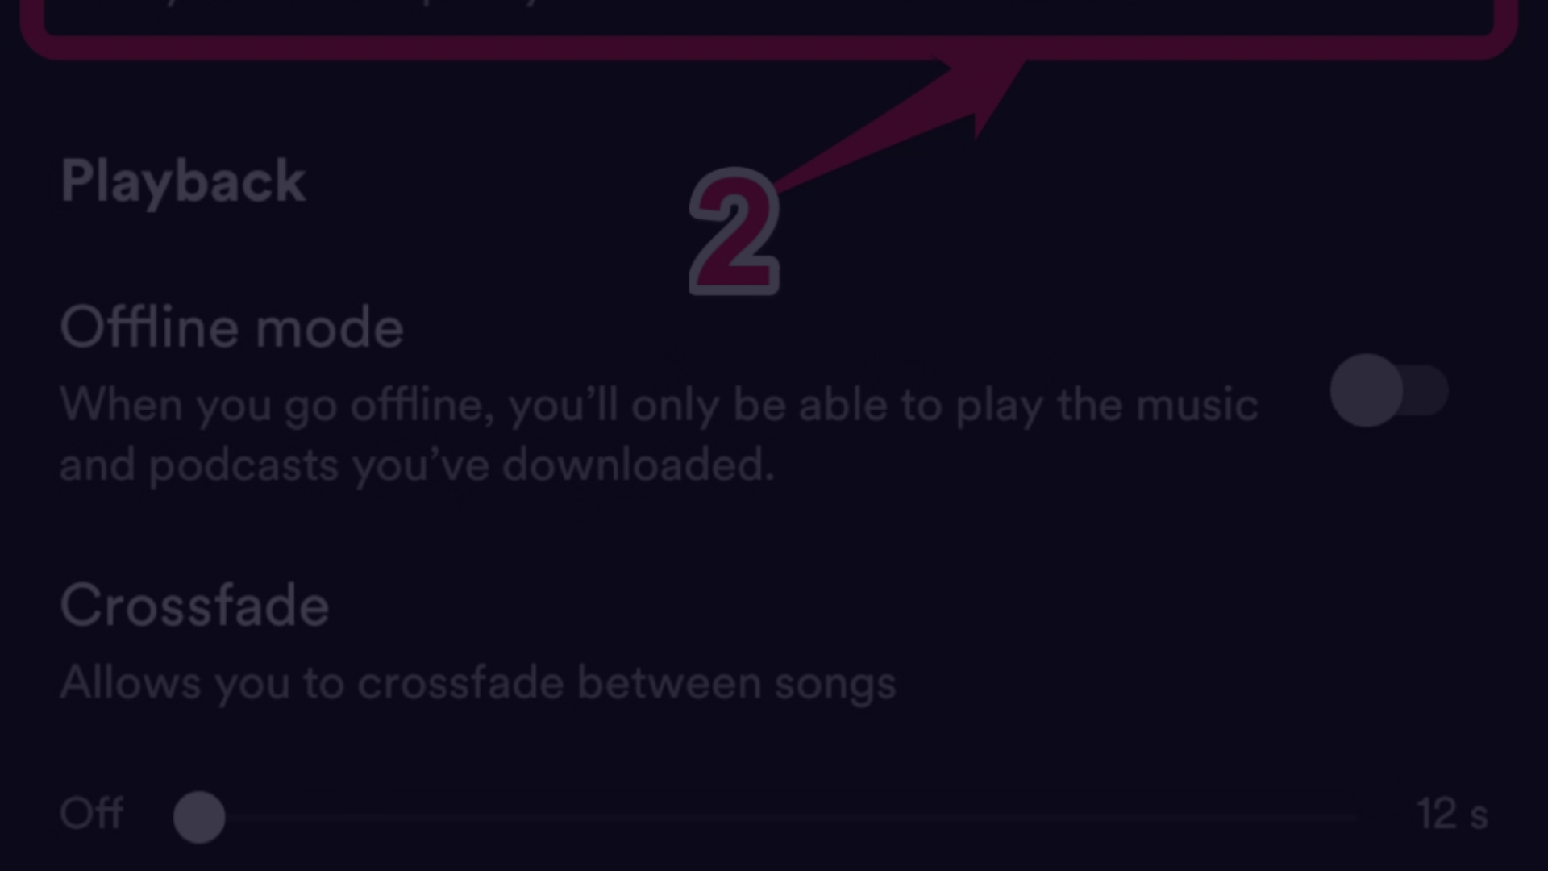
Analyzing User Behavior and Preferences
1
Data Collection
Gathering user listening habits, favorite genres, and playlist creation.
2
Genre Preferences
Identifying top genres, most played tracks, and artist discovery patterns.
3
User Engagement
Assessing time spent listening, skipping behavior, and playlist diversity.

Slide 7





Building predictive models for music recommendations
Data Collection
1
Collecting diverse music data sources
Feature Engineering
2
Extracting meaningful features from the data
Model Training
3
Training machine learning algorithms
Evaluation
4
Assessing the performance of the recommendation models

Slide 8
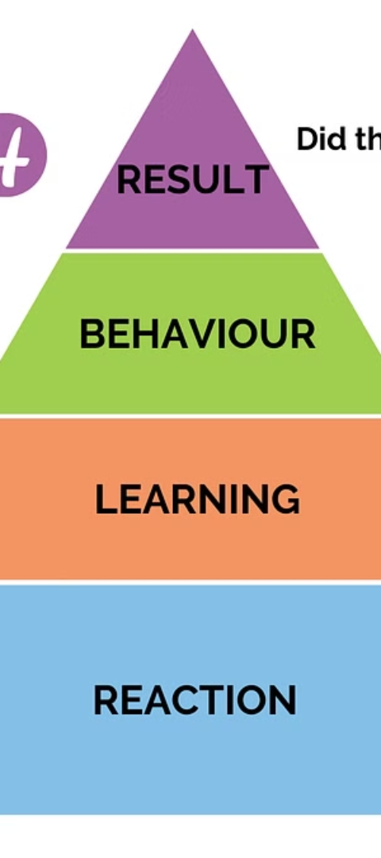



Evaluating Model Performance and Accuracy
Data Splitting
Splitting the dataset into training and testing sets.
Model Evaluation Metrics
Calculating accuracy, precision, recall, and F1-score.
Cross-Validation
Assessing model robustness and generalizability.

Slide 9
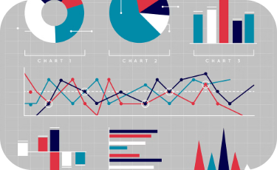
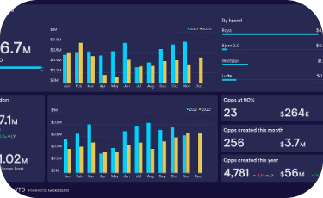
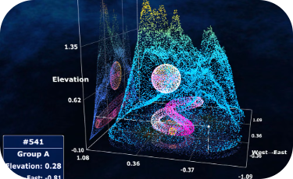
Communicating insights through data visualization
Visual Representation
Interactive Dashboards
3D Visualization
Data visualization uses charts and graphs to convey complex insights in a visually compelling manner.
Advanced 3D visualization techniques provide a deeper understanding of complex data patterns and relationships.
Interactive dashboards enable users to explore data and gain valuable insights in an intuitive way.

Slide 10
Conclusion and next steps
Insights Application
Further Analysis
Apply the insights to refine music recommendations and enhance user experience.
Explore additional datasets or new data sources to gain deeper insights.
Collaboration Opportunities
Future Research
Partner with music industry experts to enrich data analysis and model building.
Investigate emerging trends in music consumption for future predictive modeling.

